Slide 1
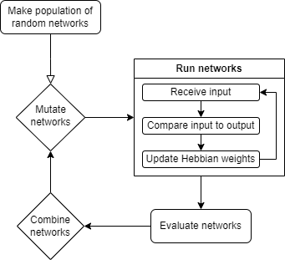
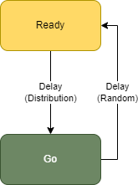
Evolving Biologically Plausible Networks for Temporal Prediction
Sondre H Elgaaen, Felix Kern, Zenas Chao
NeuroEvolution of Augmenting Topologies (NEAT)
Combine NEAT and Hebbian Learning to evolve biologically plausible RNNs capable of learning multiple time-dependent sequences.
By finding topologies that solve the problem domain, we might learn about the corresponding processes in the brain.
Ready-Go Task
A timing-task aimed at developing networks whose only function is to encode the information needed to learn timings.
A Ready-signal is sent to prepare the network for a coming Go-signal, whose timing the network is made to predict.
Network placeholder
Network placeholder
Network placeholder
Network placeholder
Results placeholder
Results placeholder
Results placeholder
Results placeholder
Hebbian placeholder
Bigger?

